Slide 1
Moving to Toronto: A Study in the Livability Factor of the City
Peter Marsh

Slide 2
Outline
Problem
Hypothesis
Data
How we did it
Results
Caveats
Conclusion
Resources

Slide 3
Problem
Where is the best place to live in Toronto?

Slide 4
Hypothesis
Best places to live in Toronto will be where Parks and other natural recreational facilities exist in close proximity

Slide 5
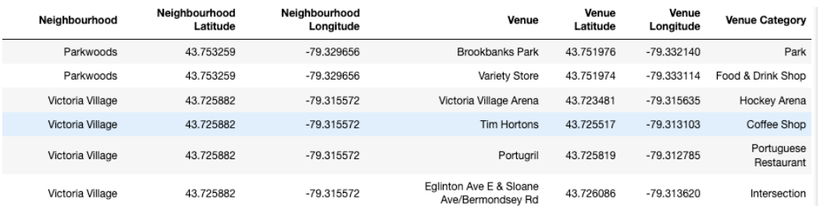
Data
Data comes from Wikipedia for the neighborhood postal codes and from foursquare for the amenity data
Used the Geocoder module to collate the data and match it up
All data was put into Pandas Dataframes, example on right

Slide 6
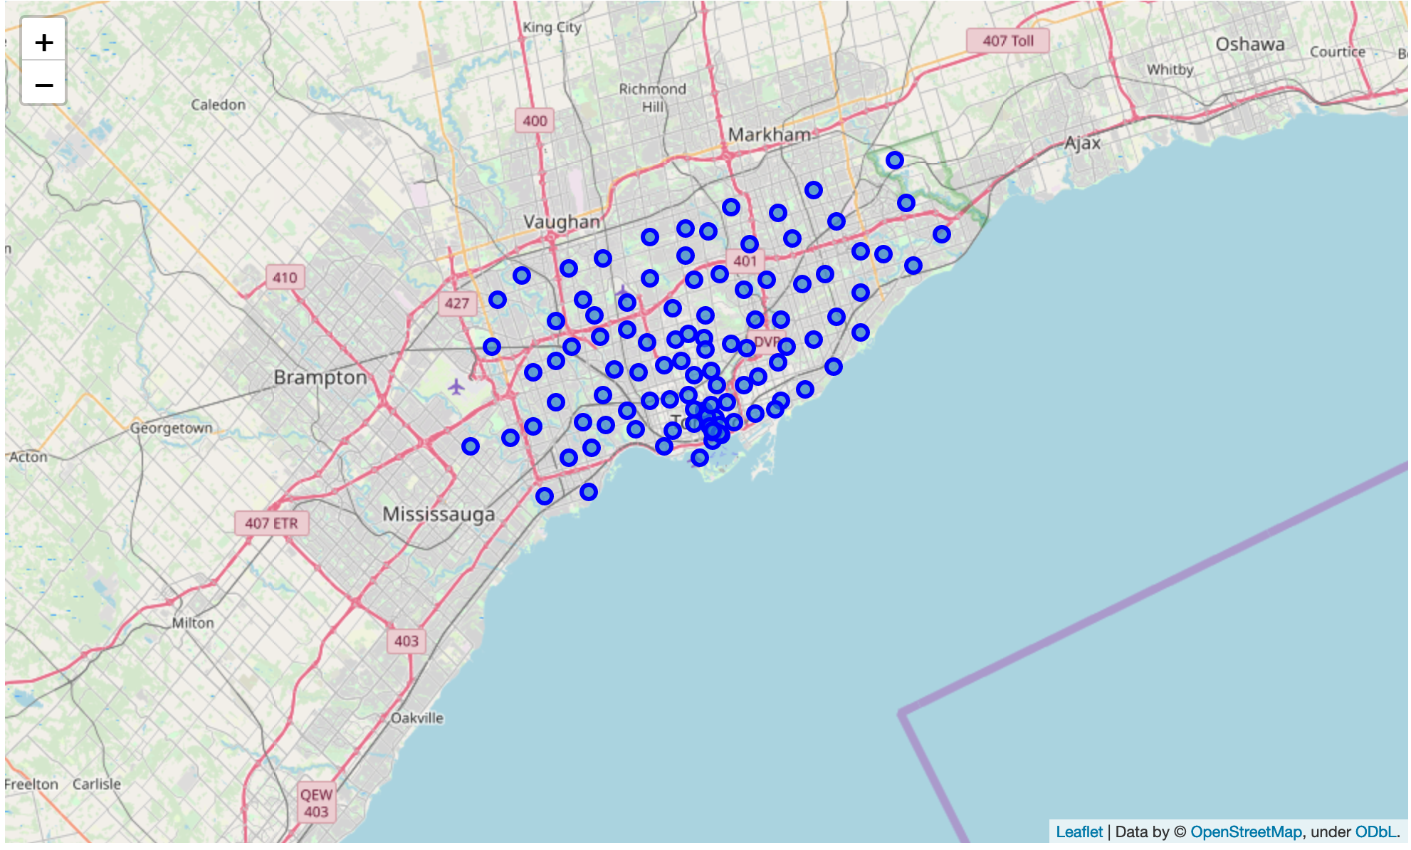
How we did it
One hot encoding to turn venues into numerical data
Group data by type of surrounding amenities using a KNN algorithm
Print out maps of venues, as well as a printed statement showing the clusters and the types of Amenities present
A Map showing all the Locations

Slide 7
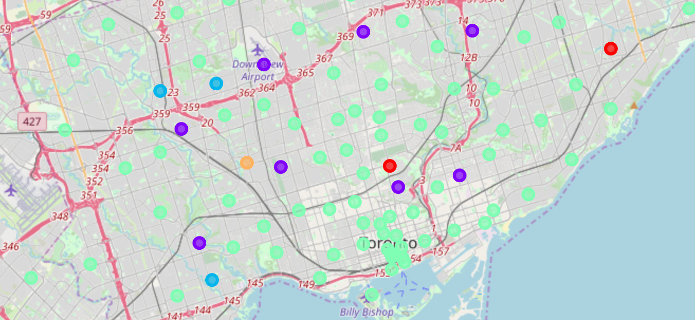
Results
Cluster 1 (Purple Dots): Public spaces. These are the ideal neighbourhoods, defined by being relatively close in proximity to natural features
Cluster 3(Green Dots): Malls. These are neighbourhoods that are in close proximity to
Clusters 0,2,4,5 (Other Colored Dots): These are the other clusters, no ascertainable defining features to them

Slide 8
Caveats
Some places meet the expectations/criteria of the cluster that they are in, while not completely aligning. The best example of this is the circled purple dot, which is nearby an airport. While the airport may qualify as a public space, the noise one would create is counter to what would qualify as a good space to live near

Slide 9
Resources
https://en.wikipedia.org/wiki/List_of_postal_codes_of_Canada:_M
https://geocoder.readthedocs.io/
https://www.coursera.org/learn/applied-data-science-capstone/home/week/3

